Slide 1






Raising Revenues: Public Financing and ‘Fiscal Space’ for Health Global Flagship Course on Health Systems Strengthening: The Challenge of Universal Health Coverage Adanna Chukwuma (Health Specialist, WB) Rose Lavado (Senior Economist, ADB) Ajay Tandon (Lead Economist, WB)

Slide 2
Health Financing Modalities
General Government Revenue
Social Health Insurance (SHI)
External Sources
Voluntary Private Insurance
Community-Based Health Insurance
Out-of-Pocket (OOP)
Each modality typically associated with different instruments for revenue generation, pooling, and purchasing of health services.
Some form of prepayment/pooling in all modalities except OOP.
Rarely do we see a “pure” form exist and all countries are hybrids.
From health financing perspective, UHC entails move away from OOP towards prepayment/pooling (typically general government revenue financing).

Slide 3
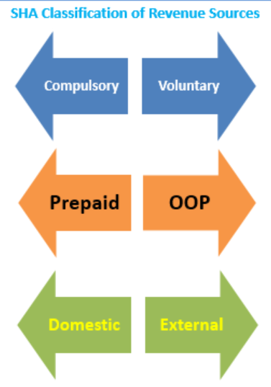
Revenue Raising Modalities
Note: where sources of revenue come from versus who manages the revenues are separate issues:
In some countries, public revenues for health are managed by private insurance schemes (e.g., India, Netherlands).
In many countries, general government revenues transfers co-finance social health insurance schemes (e.g., Indonesia, Philippines, Vietnam).
In a few countries, households/employers are mandated to purchase private insurance (e.g., Netherlands, Switzerland, USA) so private insurance is compulsory.
From health financing perspective, UHC entails move away from OOP and largely voluntary sources of revenues towards more compulsory domestic prepaid/pooled financing (typically general government revenue financing).

Slide 4
Out-of-Pocket
General Government Revenue
Social Health Insurance (SHI)
External Sources
Voluntary Private Insurance
Community-Based Health Insurance
Out-of-Pocket (OOP)
Financing by direct OOP payments made by users at point and time of contact with public and/or private providers.
There is no pooling of risks under OOP.
Providers are often paid fee-for-service.

Slide 5
Out-of-Pocket
Strengths
Patients can choose providers (although also the case with other modalities).
Discourages unnecessary over-utilization.
When combined with medical savings accounts, can promote individual pooling over time.
Weaknesses
Inequitable: connects access to health care with ability to pay; generally regressive.
Inefficient: deters utilization; constrains redistributive capacity of health systems.
No pooling of risk: exposes individuals to health as well as large financial shocks.
“Negative user fees” are often what is needed to stimulate utilization, especially for preventive care.
Examples
Azerbaijan, Armenia, Afghanistan, Yemen, Iraq: >75% total health expenditures is OOP.
Other prominent examples: Nigeria, India, Pakistan.

Slide 6
Community-Based Health Insurance
General Government Revenue
Social Health Insurance (SHI)
External Sources
Voluntary Private Insurance
Community-Based Health Insurance
Out-of-Pocket (OOP)
Not-for-profit prepayment plans for health, with community control and generally voluntary membership.
Pooling at the community level.
Care provided through public, NGO, or private facilities.

Slide 7
Community-Based Health Insurance
Strengths
Promotes prepayment.
Plays a role in mobilizing additional resources, providing access and financial protection in low-income settings.
Provide some form of coverage, better than not having any.
Weaknesses
Access and financial protection impact are limited due to the small size of most schemes.
Financial sustainability of most schemes is questionable.
Impact on service delivery usually limited.
Examples
Rwanda, Ethiopia.

Slide 8
Voluntary Private Insurance
General Government Revenue
Social Health Insurance (SHI)
External Sources
Voluntary Private Insurance
Community-Based Health Insurance
Out-of-Pocket (OOP)
Financing via private voluntary prepayment contributions
Pooling done by for- and/or non-profit private insurance organizations.
Different forms of provider payment mechanisms.

Slide 9
Voluntary Private Insurance
Strengths
Increases financial protection and access to health services for those choosing and able to pay.
When an “active purchasing” function is present it may also encourage better quality and cost-efficiency of health care providers.
Weaknesses
Adverse selection (only the sick buy insurance).
Generally not effective in reducing cost pressures.
May be inequitable without public intervention either to subsidize premiums or regulate insurance content and price.
Applicability in developing countries requires well-developed financial markets and strong regulatory capacity.
Often associated with high administrative costs.
Examples
Bahamas, South Africa.

Slide 10
External Sources
General Government Revenue
Social Health Insurance (SHI)
External Sources
Voluntary Private Insurance
Community-Based Health Insurance
Out-of-Pocket (OOP)
Resources from external sources: bilateral aid, multilateral organizations, external philanthropic organizations, etc.
Financing channeled either via government budget and/or via NGOs or other non-public providers.

Slide 11
External Sources
Strengths
Can be critical in conflict/post-conflict settings.
Allows low-income countries to provide access to services that they would normally not be able to afford (e.g., HIV/AIDS).
Financing often comes with much-needed technical assistance.
Introduction of procurement, financial management, and monitoring systems that are often superior to those in host country.
Weaknesses
Key challenges with regard to harmonization, additionality, predictability, and alignment with national priorities.
Can skew and distort service delivery in capacity-constrained settings.
Financial and programmatic sustainability is challenging when countries “graduate” from external financing.
Examples
Mozambique, Micronesia, Liberia, Malawi, Sierra Leone: >50% total health expenditures is externally financed.
Other prominent examples: Haiti, Solomon Islands, Tanzania, Uganda, Rwanda: >25%; Low income countries with external share~10% Nepal, Comoros.

Slide 12
Social Health Insurance
General Government Revenue
Social Health Insurance (SHI)
External Sources
Voluntary Private Insurance
Community-Based Health Insurance
Out-of-Pocket (OOP)
Resources from mandatory earmarked payroll/income contributions by employers and employees; in modern social health insurance programs, governments pay contributions on behalf of poor/vulnerable.
Typically funds pooled by independent/quasi-independent insurance agency/“social health insurance fund”; can also be compulsory private insurance.
Different forms of purchasing and provider payment mechanisms; rarely line-item budgets.

Slide 13
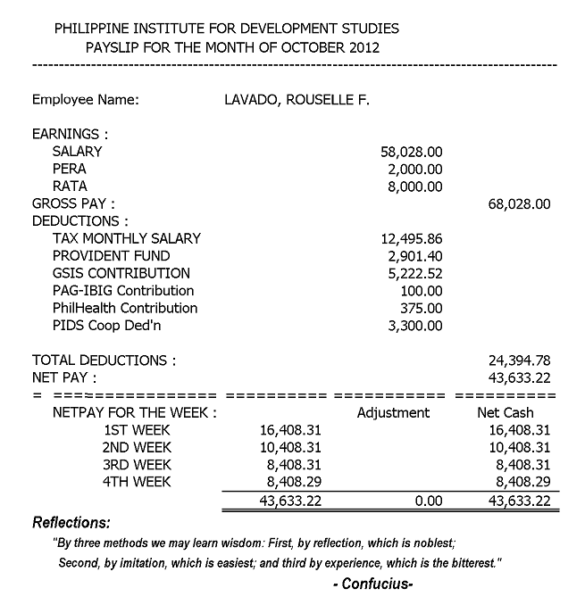
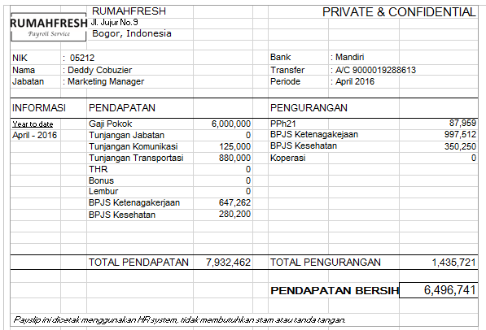
Social Health Insurance: Examples of Payroll from IDN & PHL

Slide 14
Social Health Insurance
Strengths
Additional revenue source: “benefit tax” and contributions from employers.
Removes health financing from annual general government appropriation process.
Facilitates organizational change (e.g., purchaser-provider split; new provider payment mechanisms; integration of public-private providers).
Can enhance transparency and accountability, linking financing with clearly defined benefits.
Weaknesses
Difficult to mandate and collect contributions in countries with large levels of informality and self-employed workers.
Often requires extensive subsidization/co-financing from general government revenues in developing countries so may not yield much in terms of revenue generation.
Mandatory payroll contributions can increase labor costs, reduce competitiveness, and contribute to informality.
Moral hazard (over-utilization).
Examples
Germany, Netherlands, Costa Rica, Slovenia: >65% total health expenditures is social health insurance.
Other prominent examples: Estonia, France, Belgium.
Compulsory private insurance: USA, Netherlands, Switzerland.

Slide 15
UHC ≠ SHI
UHC is a health system objective, not a health financing model; and SHI is not a necessary precondition for attaining UHC.
Many developing countries claim to have attained or are attaining UHC without SHI (e.g., Brazil, Sri Lanka, Malaysia).
Many other countries have attained or are attaining UHC using hybrid financing modalities: e.g., SHI augmented by general government revenue financing.

Slide 16
General Government Revenue
General Government Revenue
Social Health Insurance (SHI)
External Sources
Voluntary Private Insurance
Community-Based Health Insurance
Out-of-Pocket (OOP)
Resources from general government revenues including from: “direct” taxes (e.g., on income, payroll, property, wealth, and corporate profits); “indirect” taxes (e.g., on consumption such as sales tax, VAT, excise tax, export and import duties); and other non-tax revenue sources (e.g., from natural resources such as oil, fisheries, etc.).
Pooling is at government budget level, or sometimes with purchasing agency.
Purchasing arrangements vary, often line-item budgets transferred to public-owned facilities; sometimes transfers to purchasing agency that contracts both public and private providers.

Slide 17
General Government Revenue
Strengths
Broad revenue base comprising tax and non-tax sources;
Pool risks for entire population. Easy to extend coverage to all, including those in informal sector.
Financial burden of financing health (and other sectors) can be spread across entire population.
Can be a progressive source of financing in some countries.
Weaknesses
Potentially unstable source due to annual budget process, sensitivity to political priorities, weaknesses in public financial management, and exposure to macroeconomic volatility.
Poverty, large informal share of economy, and capacity constraints limit revenue-generating capacity in many developing countries.
May be regressive in some countries; “excessive” taxation may have adverse macroeconomic implications.
Moral hazard (over-utilization).
Examples
Tuvalu, Seychelles, Brunei, Kiribati: >90% total health expenditures is domestic general government revenue financed.
Other prominent examples: UK, Australia, Canada, Norway, Denmark, Sweden, Italy, Malaysia, New Zealand, Spain, Portugal.

Slide 18
‘Fiscal Space’ for Health
Systematic assessment of the need, ability, and/or willingness of countries to increase public financing for health in a sustainable, efficient, and equitable manner
Complementary to assessments that might indicate that more public financing for health may be required; important to understand why additional public financing might be needed.
Forward-looking medium-term assessment; not just about finding additional resources but also about recognizing constraints to increasing public financing for health.
Situates public financing for health within broader macro-fiscal context; underscores the fact that the health may have to “compete” with other sectors for scarce public resources.
Assessing fiscal space implies analyzing pros and cons of different options, including learning about ‘good practice’ examples from other countries where relevant.

Slide 19
‘Fiscal Space’ for Health

Slide 20
Tyranny of Mathematics
GDP
per
Capita

Slide 21





GDP = C + I + G + (X-M)
Consumption expenditures
(C)
Investments
(I)
Public expenditures
(G)
Exports
(X)
Imports
(M)
Household expenditures on durable and non-durable goods, and services
Business investments and purchases by private entities
Salaries of public servants, capital investments and operating expenditures of the government
Gross amount of products produced by country for other nation’s consumption
Gross amount of products consumed by country produced in other nation

Slide 22
Tyranny of Mathematics
Public Expenditure Share of GDP
GDP
per
Capita
X

Slide 23
Tyranny of Mathematics
Health Share of Public Expenditure
Public Expenditure Share of GDP
GDP
per
Capita
X
X

Slide 24
Tyranny of Mathematics
Health Share of Public Expenditure
Public Expenditure Share of GDP
GDP
per
Capita
Public Expenditure on Health per Capita
X
X
=

Slide 25
Tyranny of Mathematics
Sector-Specific Revenues
General Government Revenues
Health Share of Public Expenditure
Public Expenditure Share of GDP
GDP
per
Capita
Public Expenditure on Health per Capita
X
X
=
Development Assistance
Deficit Financing

Slide 26
Tyranny of Mathematics
Sector-Specific Revenues
General Government Revenues
Health Share of Public Expenditure
Public Expenditure Share of GDP
GDP
per
Capita
Public Expenditure on Health per Capita
Health
Outputs and
Outcomes
X
X
=
Development Assistance
Deficit Financing
Other Determinants

Slide 27

Tyranny of Mathematics
Health Share of Public Expenditure
Public Expenditure Share of GDP
GDP
per
Capita
Public Expenditure on Health per Capita
Health
Outputs and
Outcomes
X
X
=
Example from Armenia (circa 2016)
6% X 27% X US$3,700 = US$60
Public
Health
GDP per capita

Slide 28
Assessing ‘Fiscal Space’ for Health: Examining Options
Deriving implications for health
from a country’s overall fiscal space
framework, e.g., as a result of conducive
macroeconomic conditions.
Conducive macroeconomic conditions
Reprioritization
Sector-specific domestic revenue sources
Development assistance
Efficiency
Improving the efficiency
of existing and/or new
sector outlays.
Focusing on the extent to
which health might be
reprioritized within the
government budget.
Evaluating the use of
additional sector-specific
financing from
external sources.
Examining pros and cons of
sector-specific means to raising
additional revenues, e.g., earmarked income/consumption and sin taxes, etc.

Slide 29
Assessing ‘Fiscal Space’ for Health: Examining Options
Deriving implications for health
from a country’s overall fiscal space
framework, e.g., as a result of conducive
macroeconomic conditions.
Conducive macroeconomic conditions
Reprioritization
Sector-specific domestic revenue sources
Development assistance
Efficiency
Improving the efficiency
of existing and/or new
sector outlays.
Focusing on the extent to
which health might be
reprioritized within the
government budget.
Evaluating the use of
additional sector-specific
financing from
external sources.
Examining pros and cons of
sector-specific means to raising
additional revenues, e.g., earmarked income/consumption and sin taxes, etc.

Slide 30
Tyranny of Mathematics
Health Share of Public Expenditure
Public Expenditure Share of GDP
GDP
per
Capita
Public Expenditure on Health per Capita
Health
Outputs and
Outcomes
X
X
=
Example from Armenia
6% X 27% X US$3,700 = US$60
Public
Health
GDP per capita

Slide 31
Actual/Projected Economic Growth, 2007-2023
Notes:
+ Economy expected to double in 13 years

Slide 32
Tyranny of Mathematics
Health Share of Public Expenditure
Public Expenditure Share of GDP
GDP
per
Capita
Public Expenditure on Health per Capita
Health
Outputs and
Outcomes
X
X
=
Example from Armenia
6% X 27% X US$3,700 = US$60
6% X 27% X US$7,400 = US$120
Public
GDP per capita
Health

Slide 33

India
Public spending on health share of GDP at <1% of GDP over 2000-2016.
However, public expenditure on health increased by 2.5 times in real per capita terms over the same period because GDP per capita grew at 5.5% over the same time period;
India example underscores the importance of strong economic growth for fiscal space for health, even if nothing else changes: additionality of public resources for health underpinned expansion of the National Health Mission (NHM) program in India, a large infusion of financing for improvements in primary care and other similar programs.

Slide 34
Tyranny of Mathematics
Health Share of Public Expenditure
Public Expenditure Share of GDP
GDP
per
Capita
Public Expenditure on Health per Capita
Health
Outputs and
Outcomes
X
X
=
Example from Armenia
6% X 27% X US$3,700 = US$60
Public
Health
GDP per capita

Slide 35
Public Revenues/Expenditures as Share of GDP
Revenues
Expenditures
Average
Notes:
+ 20% of GDP are tax revenue share

Slide 36
Public Debt & Deficits, 2017

Slide 37

Tyranny of Mathematics
Health Share of Public Expenditure
Public Expenditure Share of GDP
GDP
per
Capita
Public Expenditure on Health per Capita
Health
Outputs and
Outcomes
X
X
=
Example from Armenia
6% X 27% X US$3,700 = US$60
6% X 31% X US$3,700 = US$69
Public
GDP per capita
Health

Slide 38
Assessing Fiscal Space for Health: Examining Options
Deriving implications for health
from a country’s overall fiscal space
framework, e.g., as a result of conducive
macroeconomic conditions.
Conducive macroeconomic conditions
Reprioritization
Sector-specific domestic revenue sources
Development assistance
Efficiency
Improving the efficiency
of existing and/or new
sector outlays.
Focusing on the extent to
which health might be
reprioritized within the
government budget.
Evaluating the use of
additional sector-specific
financing from
external sources.
Examining pros and cons of
sector-specific means to raising
additional revenues, e.g., earmarked income/consumption and sin taxes, etc.

Slide 39
Tyranny of Mathematics
Health Share of Public Expenditure
Public Expenditure Share of GDP
GDP
per
Capita
Public Expenditure on Health per Capita
Health
Outputs and
Outcomes
X
X
=
Example from Armenia
6% X 27% X US$3,700 = US$60
Public
Health
GDP per capita

Slide 40
Health’s Share of Public Expenditures
Globally, large variations in extent to which health is prioritized in government budgets: ranges from <3% to almost 30%.
Political economy considerations key; results-focused reform efforts – in particular efforts to explicitly expand coverage and improve quality of spending as opposed to efforts focused only on government budgetary targets – are more likely to result in sustained and politically-feasible reprioritization.
Efficiency considerations are important: efficiency is in itself a source of effective fiscal space; but can also be important for attracting additional public resources from ministries of finance/planning.

Slide 41
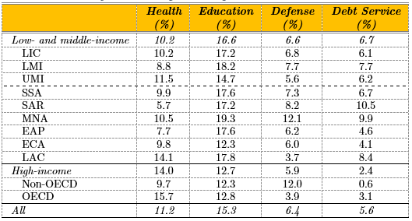
Health’s Share of Public Expenditures

Slide 42
Tyranny of Mathematics
Health Share of Public Expenditure
Public Expenditure Share of GDP
GDP
per
Capita
Public Expenditure on Health per Capita
Health
Outputs and
Outcomes
X
X
=
Example from Armenia
6% X 27% X US$3,700 = US$60
11% X 27% X US$3,700 = US$110
Public
Health
GDP per capita

Slide 43

Thailand
Health’s share of public expenditures increased after introduction of Universal Coverage Scheme (UCS) in 2001/2002.
UCS expanded non-contributory coverage to over 18 million people who were not previously covered by any social health insurance scheme (UCS currently covers ~75% of Thailand’s population).
UCS is general tax-financed: contributions are paid by government (~US$100/member).

Slide 44
Assessing Fiscal Space for Health: Examining Options
Deriving implications for health
from a country’s overall fiscal space
framework, e.g., as a result of conducive
macroeconomic conditions.
Conducive macroeconomic conditions
Reprioritization
Sector-specific domestic revenue sources
Development assistance
Efficiency
Improving the efficiency
of existing and/or new
sector outlays.
Focusing on the extent to
which health might be
reprioritized within the
government budget.
Evaluating the use of
additional sector-specific
financing from
external sources.
Examining pros and cons of
sector-specific means to raising
additional revenues, e.g., earmarked income/consumption and sin taxes, etc.

Slide 45
Tyranny of Mathematics
Health Share of Public Expenditure
Public Expenditure Share of GDP
GDP
per
Capita
Public Expenditure on Health per Capita
Health
Outputs and
Outcomes
X
X
=
Sector-specific earmark
Example from Armenia
6% X 27% X US$3,700 = US$60
Public
Health
GDP per capita

Slide 46

Sector-Specific Revenue Sources
Earmarked revenues (e.g., social health insurance, “sin” taxes, earmarking VAT, etc.) examples of sector-specific revenue sources for health.
Key questions: why earmark, and are earmarked resources for health truly consequential and additional?
Going Universal book found prevalence of earmarking for health in several countries: Guatemala; Chile; Ghana; Mexico; Philippines; Tunisia; Colombia, etc.

Slide 47
Earmarked Payroll Taxes Large Source of Financing in Some Countries
Top ten countries with highest social health insurance share of total health spending
San Marino | 79%
Monaco | 77%
Germany | 72%
Bosnia & Herzegovina | 68%
Slovenia | 66%
Costa Rica | 66%
Croatia | 63%
Estonia | 62%
Poland | 59%
Colombia | 59%
Increasing contribution rates from formal sector often a key fiscal space question.
Social health insurance often introduced as a way to collect additional revenues for health, especially from employers.
Interplay: social health insurance, competitiveness, informality, ageing, tax evasion.

Slide 48
Levels of Informality

Slide 49
Non-Payroll Earmarked Taxes
Sin taxes in several countries
Earmarking VAT for health in Ghana
Health “cess” of 1% of income tax in India
Bhutan Health Trust Fund
Taxing consumption of unhealthy products to prevent NCDs
Most forms of earmarking unpopular with ministries of finance: introduces rigidities in allocations across sectors; impact on revenues can vary, dependent on “elasticity” of response.
Why earmark and whether or not resources are truly additional?

Slide 50

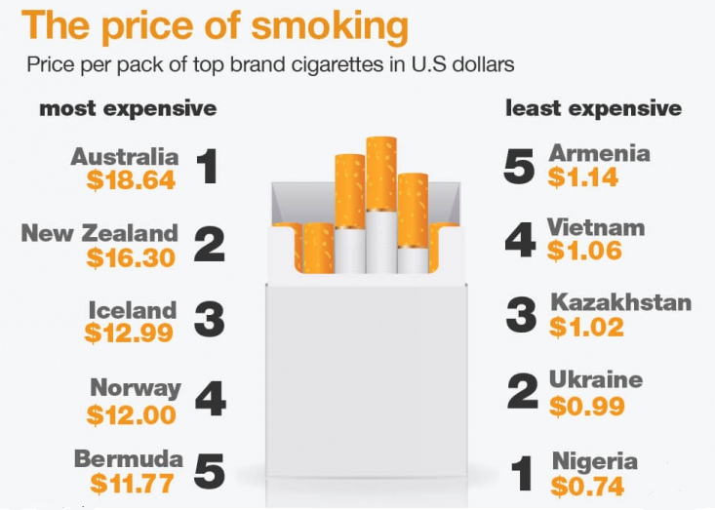

Tobacco Taxes in Armenia
Current Retail Price of 20 Cigarette pack = 600 AMD ($1.25)
Australia
US$ 15.80
Belarus
US$ 0.46
Cook Islands
US$ 15.43
Afghanistan
US$ 0.44
New Zealand
US$ 15.36
Guinea
US$ 0.39
Non-taxed cost
Cigarette tax (210 AMD)
Norway
US$ 12.69
Armenia
$1.25
Paraguay
US$ 0.37
UK
US$ 10.94
Syria
US$ 0.27
Price of 20 Cigarette pack (with tax increase) = 910 AMD ($1.90)
Scenario | Public expenditure on health (AMD) | Public expenditure (AMD) | Health Share of Public Expenditure | Public Expenditure Share of GDP
Current tobacco tax rate | 84,743,040,000 ($ 176,254,242) | 1,370,592,000,000 ($ 2,850,648,918) | 6% | 27%
Increased tobacco tax rate | 187,103,767,641 ($ 1,233,378,467) | 1,472,952,727,641 ($ 3,063,545,606) | 13% | 29%
Additional tax revenue (all goes to health) | 102,360,727,641 ($ 212,896,688) | 102,360,727,641 ($ 212,896,688) | - | -
Non-taxed cost
Cigarette tax (637 AMD)
Notes:
The market price of cigarette in Armenia is one of cheapest not only in the region but in the world (US1.25 per pack). Globally, the average market price of one pack of cigarette is 3.3 USD.
· The low market price of cigarette is attributed to low tax burden in the country (percentage of total excise tax to total market price) -35%, way below the WHO-recommended tax burden (70%).

Slide 51
Tyranny of Mathematics
Health Share of Public Expenditure
Public Expenditure Share of GDP
GDP
per
Capita
Public Expenditure on Health per Capita
Health
Outputs and
Outcomes
X
X
=
Sector-specific earmark
Example from Armenia
6% X 27% X US$3,700 = US$60
13% X 29% X US$3,700 = US$140
Public
Health
GDP per capita
Notes:
Based on the simulation, earmarking all tobacco revenues ($195 million) for health will increase the general health expenditure as a share of government expenditure from 10% to 12%, and the general government expenditure share of GDP by 0.6%
In a regime where health is a high priority (10% of total government budget) macro-fiscal environment is conducive (government spending relative to GDP - 30%), and robust economy (double current GDP per capita), earmarking all tobacco tax revenues can complement higher public spending on health. Perhaps we need to highlight that tobacco taxes should complement other drivers of higher public spending on health and not the panacea.

Slide 52
Assessing Fiscal Space for Health: Examining Options
Deriving implications for health
from a country’s overall fiscal space
framework, e.g., as a result of conducive
macroeconomic conditions.
Conducive macroeconomic conditions
Reprioritization
Sector-specific domestic revenue sources
Development assistance
Efficiency
Improving the efficiency
of existing and/or new
sector outlays.
Focusing on the extent to
which health might be
reprioritized within the
government budget.
Evaluating the use of
additional sector-specific
financing from
external sources.
Examining pros and cons of
sector-specific means to raising
additional revenues, e.g., earmarked income/consumption and sin taxes, etc.

Slide 53
Tyranny of Mathematics
Health Share of Public Expenditure
Public Expenditure Share of GDP
GDP
per
Capita
Public Expenditure on Health per Capita
Health
Outputs and
Outcomes
X
X
=
Example from Armenia
6% X 27% X US$3,700 = US$60
Public
Health
GDP per capita

Slide 54
Inefficiencies in the Health Sector
Wrong staff mix
Absenteeism
Share wasted
Ghost workers
Over-prescription
Low drug quality
Counterfeit
Under-use of generics
Hospital size
Length of stay
Corruption
Fraud
Excessive procedures
Equipment overuse
Medical error
Poor quality care
Total health spending
Sources of inefficiency

Slide 55

Zero Mark-Up Policy in China
Provider payment mechanisms incentivized over-prescription of drugs, tests, and infusions.
23-61% of medical encounters resulted in injections; over half the prescriptions for antibiotics deemed unnecessary.
Provider incentives for higher-profit, branded products also indirectly reduced the availability of essential drugs.
Resulted in very high levels of and increases in drug expenditures.
In 2009, essential medicines program introduced along with zero-profit drug policy, bulk procurement, and provision of subsidies to providers to compensate for potential loss in revenues.
Public primary care facilities were authorized to stock and prescribe only drugs on essential list.
Resulted in reductions in medicine prices and improved availability of essential drugs; nevertheless, loss in revenue led to an increase in doctor charges.

Slide 56

Merging Social Health Insurance Schemes in South Korea
Three types of social health insurance funds existed:
Employees
School teachers and civil servants
Self-employed
Problems, especially for self-employed funds:
Fiscal deficits common
High administrative costs
Inefficient risk pooling, managed by 350 insurers
Inequities in contributions and utilization
In 2000: all funds merged into single risk pool managed by two agencies: National Health Insurance Scheme (collects revenues and processes claims) and Health Insurance Review and Assessment (purchasing, including setting benefits packages, provider payment methods, and reviewing claims.
Reduction in administrative costs from ~8% to ~2%
Savings used to expand benefits package
Collection and contribution rates have increases steadily

Slide 57
Assessing Fiscal Space for Health: Examining Options
Deriving implications for HD
from a country’s overall fiscal space
framework, e.g., as a result of conducive
macroeconomic conditions.
Conducive macroeconomic conditions
Reprioritization
Sector-specific domestic revenue sources
Development assistance
Efficiency
Improving the efficiency
of existing and/or new
sector outlays.
Focusing on the extent to
which HD might be
reprioritized within the
government budget.
Evaluating the use of
additional sector-specific
financing from
external sources.
Examining pros and cons of
sector-specific means to raising
additional revenues, e.g., earmarked income/consumption and sin taxes, etc.

Slide 58
Tyranny of Mathematics
Health Share of Public Expenditure
Public Expenditure Share of GDP
GDP
per
Capita
Public Expenditure on Health per Capita
Health
Outputs and
Outcomes
X
X
=
Example from Armenia
6% X 27% X US$3,700 = US$60
13% X 29% X US$3,700 = US$140
13% X 29% X US$7,400 = US$279
13% X 31% X US$7,400 = US$298
Public
Health
GDP per capita
Notes:
+ almost six times

Slide 59
Armenia
Example from Armenia
2005
9% X 20% X US$2,364 = US$43
Example from Armenia
2016
6% X 27% X US$3,700 = US$60

Slide 60
Armenia
GDP per capita
Example from Armenia
2005
9% X 20% X U$2,364 = US$43
Public revenues
Example from Armenia
2016
6% X 27% X US$3,700 = US$60
Public expenditures
Health’s share of public expenditures

Slide 61

China
Example from China
2005
7% X 18% X US$3,197 = US$40
Example from China
2016
9% X 32% X US$8,000 = US$230

Slide 62

Korea
Example from Korea
2005
9% X 20% X US$19, 906=$358
Example from Korea
2016
13% X 21% X US$27,835 = US$760

Slide 63
Fiscal Space Decomposition, 2005 to 2016

Slide 64
In Conclusion
Conducive macroeconomic conditions
Reprioritization
Sector-specific domestic revenue sources
Development assistance
Efficiency
Fiscal space assessments should ideally comprise: (i) needs assessments; (ii) pros and cons of different options, and the potential for generating fiscal space from each; (iii) deeper dives into the most viable options moving forward.
Important to recognize opportunities but also constraints.
Important to ensure reforms and entitlements are commensurate with resource-availability and service-delivery capacity of the health sector.

